Slide 1
Wireless & Mobile Communications
Chapter 2: Wireless Transmission
General concepts of Modulation and Multiplexing
Spread spectrum
Cellular systems

Slide 2
Introduction
Wireless Data Communication is a form of communication that uses the radio spectrum rather than a physical medium. It may carry analog or digital signals and may be used on LANs or WANs in one- or two-way networks.
While transmission over different wires typically does not cause interference , however if the transmitted frequencies are too high for a certain wire crosstalk takes place.
The frequencies used for transmission are all regulated.
Modulation is needed to transmit digital data via certain frequencies.
Radio transmission can take place using many different frequency bands. Each frequency band exhibits certain advantages and disadvantages.
Following figure gives an rough overview of the frequency spectrum that can be used for data transmission.
Notes:
Universität Karlsruhe
Institut für Telematik
Mobilkommunikation
SS 1998
Prof. Dr. Dr. h.c. G. Krüger
E. Dorner / Dr. J. Schiller

Slide 3
Spectrum Allocation
1 Mm
300 Hz
10 km
30 kHz
100 m
3 MHz
1 m
300 MHz
10 mm
30 GHz
100 μm
3 THz
1 μm
300 THz
VLF
LF
MF
HF
VHF
UHF
SHF
EHF
infrared
visible light
UV
VLF = Very Low Frequency UHF = Ultra High Frequency
LF = Low Frequency SHF = Super High Frequency
MF = Medium Frequency EHF = Extra High Frequency
HF = High Frequency UV = Ultraviolet Light
VHF = Very High Frequency
Relationship between frequency ‘f’ and wave length ‘λ’ :
λ = c/f
where c is the speed of light ≅ 3x10⁸m/s
Notes:
Universität Karlsruhe
Institut für Telematik
Mobilkommunikation
SS 1998
Prof. Dr. Dr. h.c. G. Krüger
E. Dorner / Dr. J. Schiller

Slide 4
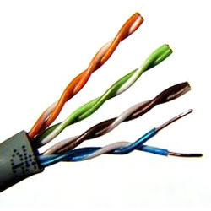
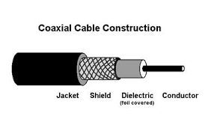
Twisted Pair : Twisted pair is the ordinary copper wire that connects home and many business computers to the telephone company. To reduce crosstalk or electromagnetic induction between pairs of wires, two insulated copper wires are twisted around each other.

Slide 5
Spectrum Allocation
In telecommunication and radio communication, spread-spectrum techniques are methods by which a signal
(e.g., an electrical, electromagnetic, or acoustic signal) generated with a particular bandwidth is deliberately spread in the frequency domain, resulting in a signal with a wider bandwidth.
Radio transmission starts at several kHz, the very low frequency (VLF) range. These are long waves.
Waves in the Low frequency (LF) range are used by submarines because they can penetrate the water .
The medium frequency (MF) and high frequency (HF) are usually for transmission of hundreds of radio stations either as amplitude modulation (AM) , as short wave (SW) between 5.9 MHz and 26.1 MHz or as frequency modulation (FM) between 87.5 MHz and 108 MHz.
Notes:
Universität Karlsruhe
Institut für Telematik
Mobilkommunikation
SS 1998
Prof. Dr. Dr. h.c. G. Krüger
E. Dorner / Dr. J. Schiller

Slide 6
Spectrum Allocation
The frequencies limiting these ranges are typically fixed by national regulation and vary from country to country.
As we move to higher frequencies , the TV stations follow.
Super high frequencies are used by fixed satellite services in the C-band (4 and 6 GHz).
The Internation Telecommunications Union (ITU) located in Geneva is responsible for world wide coordination of telecommunication activities (wired and wireless).
ITU is a sub organization of UN.
Notes:
Universität Karlsruhe
Institut für Telematik
Mobilkommunikation
SS 1998
Prof. Dr. Dr. h.c. G. Krüger
E. Dorner / Dr. J. Schiller

Slide 7
Spectrum Allocation
The ITU Radiocommunication sector (ITU-R) handles the standardization in the wireless sector, so it also handles frequency planning.
Signals
Signals are the physical representation of data.
Users of a communication system can only exchange data through the transmission of signals.
Layer I of the ISO/OSI basic reference model is responsible for the conversion of data, i.e. , bits into signals and vice versa.
Signals are functions of time and location.
Notes:
Universität Karlsruhe
Institut für Telematik
Mobilkommunikation
SS 1998
Prof. Dr. Dr. h.c. G. Krüger
E. Dorner / Dr. J. Schiller

Slide 8
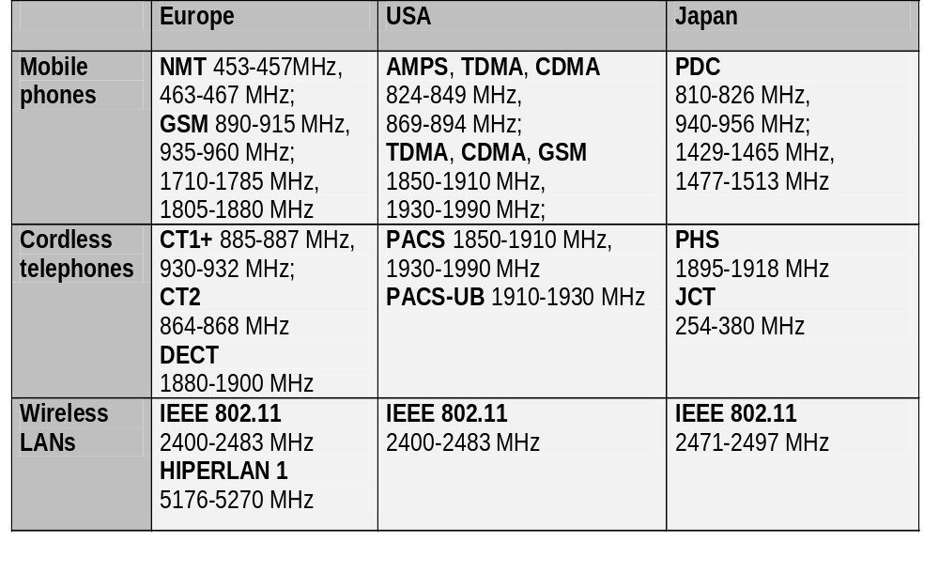
Allocated Frequencies
ITU-R holds auctions for new frequencies, manages frequency bands worldwide for harmonious usage (WRC - World Radio Conferences)

Slide 9
Multiplexing
Multiplexing is the process of combining multiple signals into one signal, over a shared medium.
The process is called as analog multiplexing if these signals are analog in nature.
If digital signals are multiplexed, it is called as digital multiplexing.

Slide 10
Multiplexing
Multiplexing was first developed in telephony. A number of signals were combined to send through a single cable.
The process of multiplexing divides a communication channel into several number of logical channels, allotting each one for a different message signal or a data stream to be transferred.
The device that does multiplexing, can be called as a MUX.
The reverse process, i.e., extracting the number of channels from one, which is done at the receiver is called as demultiplexing.
The device which does demultiplexing is called as DEMUX.

Slide 11
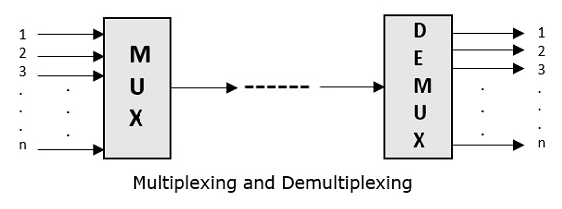
Multiplexing
The following figures illustrates the concept of MUX and DEMUX. Their primary use is in the field of communications.

Slide 12
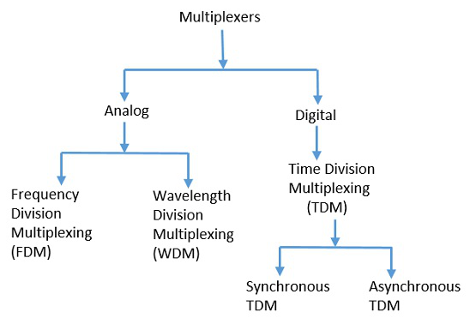
Multiplexing
Types of Multiplexers
There are mainly two types of multiplexers, namely analog and digital.
They are further divided into FDM, WDM, and TDM.

Slide 13
Multiplexing
Analog Multiplexing
The analog multiplexing techniques involve signals which are analog in nature.
The analog signals are multiplexed according to their frequency (FDM) or wavelength (WDM).
Frequency Division Multiplexing
In analog multiplexing, the most used technique is Frequency Division Multiplexing (FDM). This technique uses various frequencies to combine streams of data, for sending them on a communication medium, as a single signal.
Example − A traditional television transmitter, which sends a number of channels through a single cable uses FDM.

Slide 14
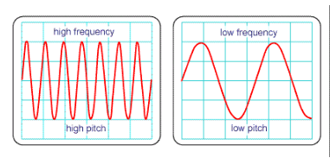

Slide 15
Multiplexing
Wavelength Division Multiplexing
Wavelength Division multiplexing (WDM) is an analog technique, in which many data streams of different wavelengths are transmitted in the light spectrum.
If the wavelength increases, the frequency of the signal decreases. A prism which can turn different wavelengths into a single line, can be used at the output of MUX and input of DEMUX.
Example − Optical fiber Communications use the WDM technique, to merge different wavelengths into a single light for the communication.

Slide 16
Multiplexing
Digital Multiplexing
The term digital represents the discrete bits of information. Hence, the available data is in the form of frames or packets, which are discrete.
Time Division Multiplexing (TDM)
In TDM, the time frame is divided into slots. This technique is used to transmit a signal over a single communication channel, by allotting one slot for each message.
Of all the types of TDM, the main ones are Synchronous and Asynchronous TDM.

Slide 17
Multiplexing
Synchronous TDM
In Synchronous TDM, the input is connected to a frame. If there are ‘n’ number of connections, then the frame is divided into ‘n’ time slots. One slot is allocated for each input line.
In this technique, the sampling rate is common for all signals and hence the same clock input is given. The MUX allocates the same slot to each device at all times.
Asynchronous TDM
In Asynchronous TDM, the sampling rate is different for each of the signals and a common clock is not required. If the allotted device, for a time slot transmits nothing and sits idle, then that slot is allotted to another device, unlike synchronous.
This type of TDM is used in Asynchronous transfer mode networks.

Slide 18
Multiplexing
Demultiplexer
Demultiplexers are used to connect a single source to multiple destinations. This process is the reverse of multiplexing. As mentioned previously, it is used mostly at the receivers.
DEMUX has many applications. It is used in receivers in the communication systems. It is used in arithmetic and logical unit in computers to supply power and to pass on communication, etc.
Demultiplexers are used as serial to parallel converters. The serial data is given as input to DEMUX at regular interval and a counter is attached to it to control the output of the demultiplexer.
Both the multiplexers and demultiplexers play an important role in communication systems, both at the transmitter and receiver sections.

Slide 19
Modulation
Communication is the basic asset of mankind through which he can exchange the information. It gives the idea of what is going around us.
We communicate with many people in our daily life. We also need the entertainment medias in our day to day life like TV, radio, browsing, News paper etc which also acts as a source of Communication.
Electronic communication includes TV, radio, Internet etc. Here we need to transmit the information bearing signal from one place to another.
To do this we need to strengthen the signal. So that the signal travels for long distances. This is what is called Modulation.

Slide 20
Modulation
A signal can be anything like a sound wave which comes out when you shout.
This shout can be heard only up to a certain distance.
But for the same wave to travel over a long distance, you’ll need a technique which adds strength to this signal, without disturbing the parameters of the original signal.

Slide 21
Modulation
What is Signal Modulation?
A message carrying signal has to get transmitted over a distance and for it to establish a reliable communication, it needs to take the help of a high frequency signal which should not affect the original characteristics of the message signal.
The characteristics of the message signal, if changed, the message contained in it also alters.
Hence it is must to take care of the message signal.
A high frequency signal can travel up to a longer distance, without getting affected by external disturbances.
We take the help of such high frequency signal which is called as a carrier signal to transmit our message signal.
Such a process is simply called as Modulation.

Slide 22
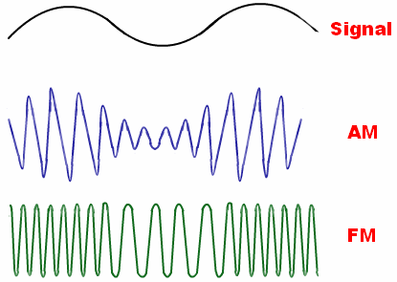
What is Modulation?
Modulation Definition :
Modulation is the process of superimposing the information contents of a modulating signal on a carrier signal (which is of high frequency) by varying the characteristic of carrier signal according to the modulating signal.
Modulation is a process in which the base band signal modifies another high-frequency signal called the carrier.

Slide 23
Modulation
Modulation is the process of changing the parameters of the carrier signal, in accordance with the instantaneous values of the modulating signal.
Need for Modulation
The baseband signals are incompatible for direct transmission. For such a signal, to travel longer distances, its strength has to be increased by modulating with a high frequency carrier wave, which doesn’t affect the parameters of the modulating signal.

Slide 24
Modulation
Advantages of Modulation
The antenna used for transmission, had to be very large, if modulation was not introduced. The range of communication gets limited as the wave cannot travel to a distance without getting distorted.
Following are some of the advantages for implementing modulation in the communication systems.
Antenna size gets reduced.
No signal mixing occurs.
Communication range increases.
Multiplexing of signals occur.
Adjustments in the bandwidth is allowed.
Reception quality improves.

Slide 25
Modulation
Signals in the Modulation Process
Following are the three types of signals in the modulation process.
Message or Modulating Signal
The signal which contains a message to be transmitted, is called as a message signal. It is a baseband signal, which has to undergo the process of modulation, to get transmitted. Hence, it is also called as the modulating signal.
Carrier Signal
The high frequency signal which has a certain phase, frequency, and amplitude but contains no information, is called a carrier signal. It is an empty signal. It is just used to carry the signal to the receiver after modulation.
Modulated Signal
The resultant signal after the process of modulation, is called as the modulated signal. This signal is a combination of the modulating signal and the carrier signal.

Slide 26
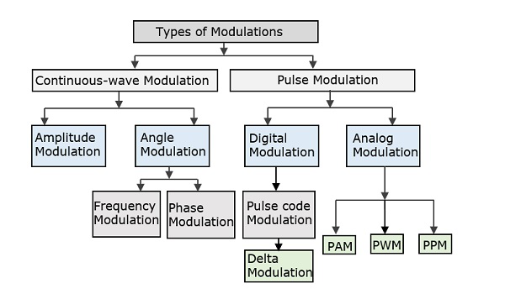
Modulation
Types of Modulation

Slide 27
Modulation
The types of modulations are broadly classified into continuous-wave modulation and pulse modulation.
Continuous-wave Modulation
In the continuous-wave modulation, a high frequency sine wave is used as a carrier wave. This is further divided into amplitude and angle modulation.
Amplitude Modulation: In this type of modulation the strength of the carrier signal is varied with the modulating signal..
Angle Modulation: In this type of modulation the angle of the carrier signal is varied with the modulating signal.

Slide 28
Modulation
The angle modulation is further divided into frequency and phase modulation.
If the frequency of the carrier wave is varied, in accordance with the instantaneous value of the modulating signal, then such a technique is called as Frequency Modulation.
If the phase of the high frequency carrier wave is varied in accordance with the instantaneous value of the modulating signal, then such a technique is called as Phase Modulation.

Slide 29
Modulation
Pulse Modulation
In Pulse modulation, a periodic sequence of rectangular pulses, is used as a carrier wave.
This is further divided into analog and digital modulation.
In analog modulation technique, if the amplitude, duration or position of a pulse is varied in accordance with the instantaneous values of the baseband modulating signal, then such a technique is called as Pulse Amplitude Modulation (PAM) or Pulse Duration/Width Modulation (PDM/PWM), or Pulse Position Modulation (PPM).

Slide 30
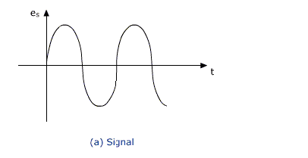
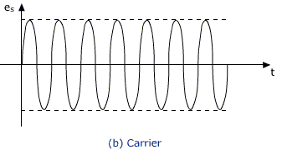
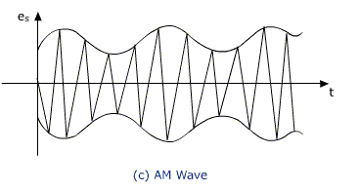
Amplitude Modulation

Slide 31
Modulation
In digital modulation,
the modulation technique used is Pulse Code Modulation (PCM) where the analog signal is converted into digital form of 1s and 0s.
As the resultant is a coded pulse train, this is called as PCM.
This is further developed as Delta Modulation (DM).
Hence, PCM is a technique where the analog signals are converted into a digital form.

Slide 32
Modulation and Demodulation
analog
baseband
signal
digital
data
digital
modulation
analog
modulation
101101001
radio transmitter
radio
carrier
analog
baseband
signal
digital
data
analog
demodulation
synchronization
decision
101101001
radio receiver
radio
carrier

Slide 33
Digital Modulation
Modulation of digital signals known as Shift Keying
Amplitude Shift Keying (ASK):
  very simple
  low bandwidth requirements
  very susceptible to interference
Frequency Shift Keying (FSK):
  needs larger bandwidth
Phase Shift Keying (PSK):
  more complex
  robust against interference
1
0
1
t
1
0
1
t
1
0
1
t

Slide 34
Advanced Frequency Shift Keying
bandwidth needed for FSK depends on the distance between the carrier frequencies
special pre-computation avoids sudden phase shifts
➔ MSK (Minimum Shift Keying)
bit separated into even and odd bits, the duration of each bit is doubled
depending on the bit values (even, odd) the higher or lower frequency, original or inverted is chosen
the frequency of one carrier is twice the frequency of the other
even higher bandwidth efficiency using a Gaussian low-pass filter ➔ GMSK (Gaussian MSK), used in GSM

Slide 35
Example of MSK
1
0
1
1
0
1
0
data
bit
even 0 1 0 1
even bits
odd 0 0 1 1
odd bits
signal h n n h
value - - + +
low
frequency
h: high frequency
n: low frequency
+: original signal
-: inverted signal
high
frequency
MSK
signal
t
No phase shifts!

Slide 36
Advanced Phase Shift Keying
BPSK (Binary Phase Shift Keying):
  bit value 0: sine wave
  bit value 1: inverted sine wave
  very simple PSK
  low spectral efficiency
  robust, used e.g. in satellite systems
QPSK (Quadrature Phase Shift Keying):
  2 bits coded as one symbol
  symbol determines shift of sine wave
  needs less bandwidth compared to BPSK
  more complex
Often also transmission of relative, not absolute phase shift: DQPSK - Differential QPSK (IS-136, PACS, PHS)
Q
I
1
0
10
Q
11
I
00
01
A
t
11
10
00
01

Slide 37
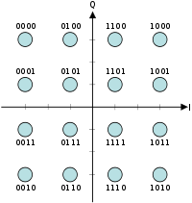
Quadrature Amplitude Modulation
Quadrature Amplitude Modulation (QAM): combines amplitude and phase modulation
it is possible to code n bits using one symbol
2^{n} discrete levels, n=2 identical to QPSK
bit error rate increases with n, but less errors compared to comparable PSK schemes
  Example: 16-QAM (4 bits = 1 symbol)
Symbols 0011 and 0001 have the same phase, but different amplitude. 0000 and 1000 have different phase, but same amplitude.
➔ used in standard 9600 bit/s modems

Slide 38
Spread spectrum technology: CDM
Problem of radio transmission: frequency dependent fading can wipe out narrow band signals for duration of the interference
Solution: spread the narrow band signal into a broad band signal using a special code
  protection against narrow band interference
protection against narrowband interference
Side effects:
  coexistence of several signals without dynamic coordination
  tap-proof
Alternatives: Direct Sequence, Frequency Hopping
power
interference
spread signal
power
signal
spread
interference
detection at
receiver
f
f

Slide 39
Effects of spreading and interference
P
P
user signal
broadband interference
narrowband interference
i)
ii)
f
f
sender
P
P
P
iii)
iv)
v)
f
f
f
receiver
2.28.1

Slide 40
Concept of Cellular Communications
In the late 60’s it was proposed to alleviate the problem of spectrum congestion by restructuring the coverage area of mobile radio systems.
The cellular concept does not use broadcasting over large areas. Instead smaller areas called cells are handled by less powerful base stations that use less power for transmission. Now the available spectrum can be re-used from one cell to another thereby increasing the capacity of the system.
However this did give rise to a new problem, as a mobile unit moved it could potentially leave the coverage area (cell) of a base station in which it established the call. This required complex controls that enabled the handing over of a connection (called handoff) to the new cell that the mobile unit moved into.
In summary, the essential elements of a cellular system are:
  Low power transmitter and small coverage areas called cells
  Spectrum (frequency) re-use
  Handoff

Slide 41
Cell structure
Implements space division multiplex: base station covers a certain transmission area (cell)
Mobile stations communicate only via the base station
Advantages of cell structures:
  higher capacity, higher number of users
  less transmission power needed
  more robust, decentralized
  base station deals with interference, transmission area etc. locally
Problems:
  fixed network needed for the base stations
  handover (changing from one cell to another) necessary
  interference with other cells
Cell sizes from some 100 m in cities to, e.g., 35 km on the country side (GSM) - even less for higher frequencies
2.35.1

Slide 42
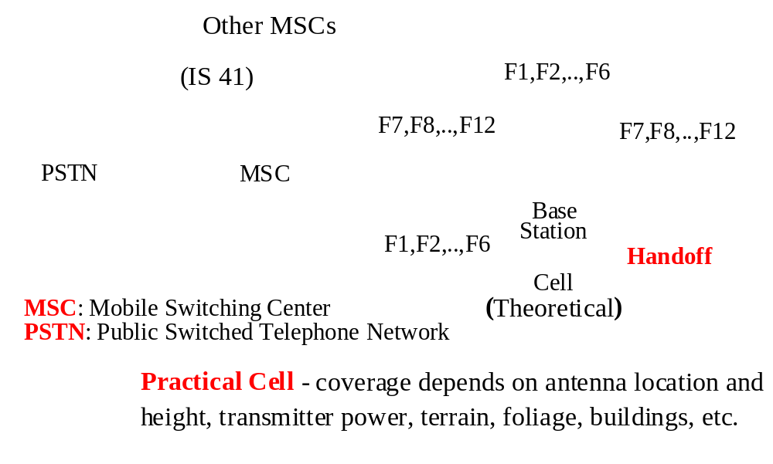
Cellular Network

Slide 43
Some Definitions
Forward path or down link - from base station down to the mobile
Reverse path or up link - from the mobile up to the base station
The mobile unit - a portable voice and/or data comm. transceiver. It has a 10 digit telephone number that is represented by a 34 bit mobile identification number -> (215) 684-3201 is divided into two parts: MIN1: 215 translated into 10bits and MIN2: 684-3201 translated into 24bits. In addition each mobile unit is also permanently programmed at the factory with a 32 bit electronic serial number (ESN) which guards against tampering.
The cell - a geographical area covered by Radio Frequency (RF) signals. It is essentially a radio communication center comprising radios, antennas and supporting equipment to enable mobile to land and land to mobile communication. Its shape and size depend on the location, height , gain and directivity of the antenna, the power of the transmitter, the terrain, obstacles such as foliage, buildings, propagation paths, etc. It is a highly irregular shape, its boundaries defined by received signal strength! But for traffic engineering purposes and system planning and design a hexagonal shape is used.

Slide 44
More definitions
The base station (BS) - a transmitter and receiver that relays signals (control and information (voice or data)) from the mobile unit to the MSC and vice versa.
The mobile switching center (MSC) - a switching center that controls a cluster of cells. Base stations are connected to the MSC via wireline links.
The MSC is directly connected to the PSTN(public switched telephone network) and is responsible for all calls related to mobiles located within its domain. MSCs intercommunicate using a link protocol specified by IS (International Standard) 41. This enables roaming of mobile units (i.e. obtaining service outside of the home base). The MSC is also responsible for billing, it keeps track of air time, errors, delays, blocking, call dropping (due to handoff failure), etc. It is also responsible for the handoff process, it keeps track of signal strengths and will initiate a handoff when deemed necessary (note to handoff or not to handoff is not a trivial issue!)

Slide 45
The Basic Cellular Communication Protocol I
Every mobile unit whether at home or roaming, has to register with the MSC controlling the area it is in. If it does not register then the MSC does not know of its existence and will not be able to process any of its calls.
The home location register (HLR) is used to keep information regarding a mobile unit/user, it is a database for storing and managing subscriber information. When roaming, a mobile unit registers with a foreign MSC and data from its HRL is relayed to the visitor location register (VLR). The VLR is a dynamic database used to store roaming mobile subscriber information. The HLR and VLR communicate via the MSCs using IS 41.
The cellular system uses out of band signalling. Most of the control information is sent over different channels from the user information (voice or data) channels. Inband signalling is used for control during the connection (disconnect, handoff, etc.)

Slide 46
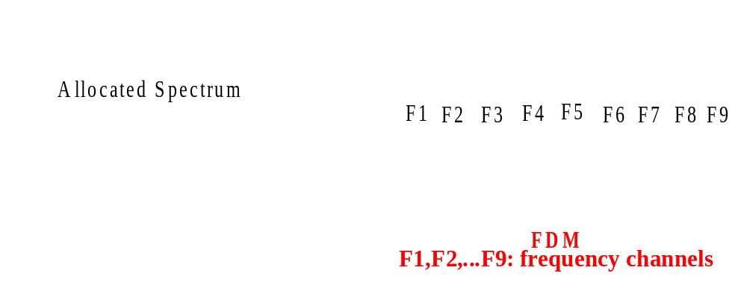
Spectrum and Capacity Issues
Spectrum is limited

Slide 47
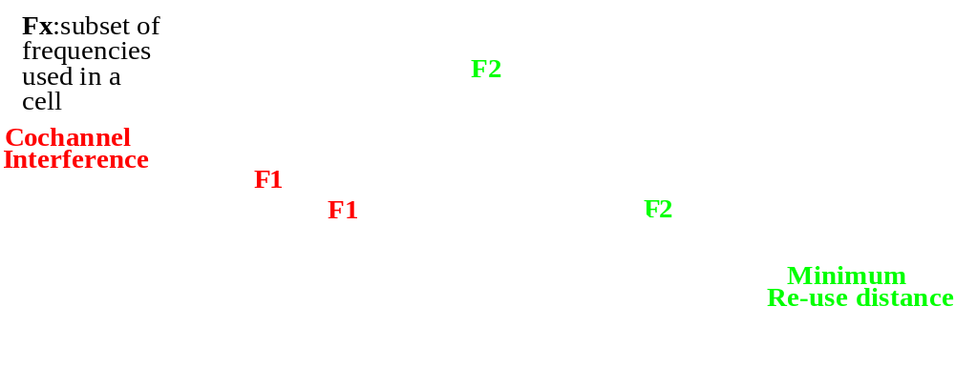
Frequency Re-use I
To be able to increase the capacity of the system, frequencies must be re-used in the cellular layout (unless we are using spread spectrum techniques).
Frequencies cannot be re-used in adjacent cells because of co-channel interference. The cells using the same frequencies must be dispersed across the cellular layout. The closer the spacing the more efficient the scheme!

Slide 48
Frequency planning
Frequency reuse only with a certain distance between the base stations
Standard model using 7 frequencies:
Fixed frequency assignment:
  certain frequencies are assigned to a certain cell
  problem: different traffic load in different cells
Dynamic frequency assignment:
  base station chooses frequencies depending on the frequencies already used in neighbor cells
  more capacity in cells with more traffic
  assignment can also be based on interference measurements
f₃
f₅
f₂
f₄
f₆
f₅
f₁
f₄
f₃
f₇
f₁
f₂
2.36.1

Slide 49
Increasing Capacity
We can see that by reducing the area of a cell we can increase capacity as we will have more cells each with its own set of frequencies.
What is drawback of shrinking the size of the cells (cell splitting)? Increase in the number of handoffs -> increased load on the system! Also need more infrastrucutre -> base stations (each cell needs a BS).
An easier solution exists, sectorization. It does not reduce handoffs, its advantage: it does not require more infrastructure.

